Slide 1

Data Mining & Machine Learning I
1. Overview of Data Mining and Machine Learning

Slide 2
1. Overview of Data Mining and Machine Learning
1.1 History & Evolution
1.2 Data Science Methodologies
1.3 Taxonomy & Techniques
1.4 Summary

Slide 3
1.1 History & Evolution
Introduction
Statistics
Data Science
Data Mining
Statistical Learning
Machine Learning
Artificial
Intelligence
Deep Learning
Data Analytics

Slide 4
1.1 History & Evolution
Introduction
The terms ‘data science’ and ‘data mining’ often are used interchangeably, and the former has taken a life of its own as various individuals and organizations try to capitalize on the current hype surrounding it.
At a high level, data science is a set of fundamental principles that guide the extraction of knowledge from data.
Data mining is the extraction of knowledge from data, via technologies that incorporate these principles.
As a term, ‘data science’ often is applied more broadly than the traditional use of ‘data mining’, but data mining techniques provide some of the clearest illustrations of the principles of data science.

Slide 5
1.1 History & Evolution
Introduction
Data Mining has been defined as
Similar terms
Exploratory data analysis
Data driven discovery
Deductive learning
Discovery Science
Knowledge Discovery
“The nontrivial extraction of implicit, previously unknown, and potentially useful information from data”.
(Frawley et al. , 1992)

Slide 6
1.1 History & Evolution
History & Evolution
Data Analysis
Exploratory / Confirmatory Objectives
E.g., are there interesting patterns in the data?
E.g., are there distinguishing features that determine how different one group is from another group in a certain regard?
Descriptive vs. Inferential Statistics
Populations and Samples
Data analysis involves processing data
Generally, involving an iterative process
Descriptive | Inferential
Statements / observations about a set of data | Drawing conclusions that have more general validity

Slide 7
1.1 History & Evolution
History & Evolution
Data Analysis
Major impact of computing power to compel and drive forward analytic techniques
Ability to store and process (extremely) large sets of data
Statistical approach historically model driven
A postulated structure (or approximation to a structure) that leads to an understanding of the observed data
Machine Learning approach driven more by algorithmic based thinking
Algorithmic developments emerging for specific problem areas
Note: the term model is heavily overloaded and context dependent
Predictive models
Representative models
Keep this in mind for when we discuss concepts such as bias, variance, overfitting, underfitting, and generalization.

Slide 8
1.1 History & Evolution
History & Evolution
Pre 1950
1950-1990s
21st Century
Pre 1950 : classical statistical theory
1950 – 1990s : early computer age developments
21st Century : modern developments

Slide 9
1.2 Data Science Methodologies
Data Science Methodologies
Let’s first discuss what we mean by
DATA

Slide 10
1.2 Data Science Methodologies
Data Explosion
Information Stored
Information Used
Information Created

Slide 11
1.2 Data Science Methodologies
What is Information?
Data vs. Information
Data are raw facts
Information comes when data is processed, organised, and structured in some way.
Data is given a context and meaning
E.g.,
2, 3, 5, 7, 11, 13, 17, 19
By itself without being presented in a context this list of numbers has no implied meaning – it is a set of data
‘The set of prime numbers less than 20 appear in the list above’
When described in this manner we have some information

Slide 12
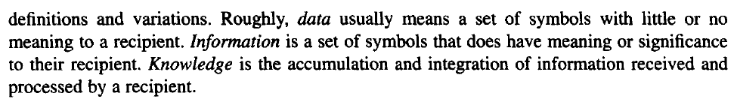
1.2 Data Science Methodologies
What is Information?
Information is something that
is represented by a set of symbols,
has some structure
can be read and to some extent understood by users of information
Meadow
Information
See https://courses.washington.edu/isports/readings/Meadow_and_Yuan.pdf
Data
Knowledge
Data to Information to Knowledge continuum

Slide 13
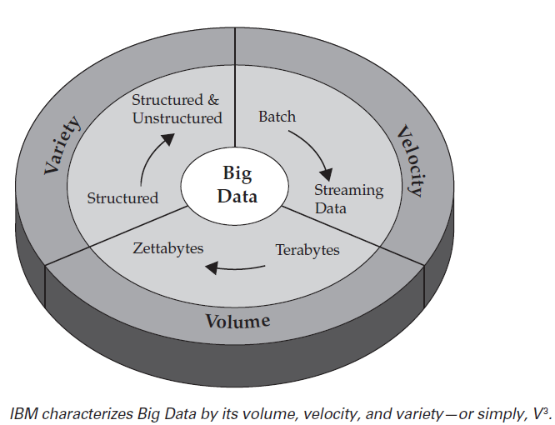
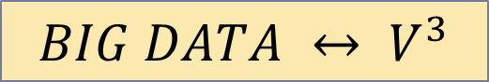
1.2 Data Science Methodologies
Volume / Variety / Velocity
Can describe BIG DATA in terms of Volume / Variety / Velocity (IBM)
$$BIG DATA ↔ V^{3}$$
from P. Zikopoulos, C. Eaton et al, 2012, Understanding Big Data, Analytics for Enterprise Hadoop and Streaming Data, McGraw Hill

Slide 14
1.2 Data Science Methodologies
Data Science Methodologies
Data – what should we expect?
Missing values
Distortions
Mis-recordings
Inadequate sampling
Outliers
Getting familiar with the data itself can be very challenging!

Slide 15

1.2 Data Science Methodologies
Data Science Methodologies
Varying Dataset Characteristics
Large number of records with a relatively small number of variables
Smaller number of records with possibly thousands of variables
Imbalanced datasets
Can lead to issues with –
Covariance
Correlation
The curse of dimensionality
We also need to be cognizant of the manner in which data has been collected and the (original) purpose for which the data was collected.
GIGO

Slide 16


1.2 Data Science Methodologies
A Rough Guide
Example

Slide 17

1.2 Data Science Methodologies
A Rough Guide
Example
Facebook: no dirty campaigns
We’re going to lose ☹
I tell the truth
We’re treated equally
I (re)present me, not my party
We’re most positive about the majority party
Study on 187 German Federal Politicians
55k posts (2M words), 230k comments (6.5M words), 1.5M likes
(Caton et al., 2015)

Slide 18
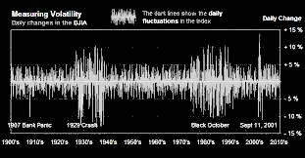
1.2 Data Science Methodologies
A Rough Guide
Example
REST API
Some programming language
Some programming language
Some DB Engine
Some connection
Some text analytics library

Slide 19
1.2 Data Science Methodologies
A Rough Guide
What (roughly) do we need to do?
Get some data: Facebook posts / comments in this case
Then we need to organise the data somehow
e.g. by language, political party, temporal aspects, etc.
Identify the subset of data that we actually need
E.g. if we are only interested in Irish politicians, we exclude German politicians
E.g. if we only want to assess politician posts, we can ignore audience comments
Etc.
Then we need to prepare (pre-process) the data for analysis
E.g. remove superfluous posts, handle emoji/emoticons
Having pre-processed the data, we may need to change its representation (transform the data) to make it easier to analyse
For FB data, this may mean some form of text processing, deriving some summarisation values (e.g. no. of posts, reactions, comments) etc. that are appropriate to our question
Analyse the data
Interpret the results
Have such processes been codified in any way?

Slide 20
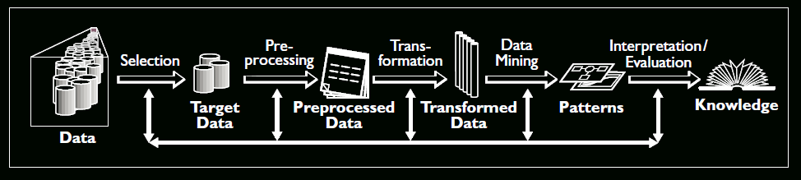
1.2 Data Science Methodologies
KDD
Knowledge Discovery in Databases
A methodology defined by a sequence of steps
Iterations and looping back to previous steps in the process are possible with KDD
KDD is often applied interactively and iteratively.
(Brachman and Anand, 1996; Fayyad, 1996; Fayyad et al., 1996)

Slide 21
1.2 Data Science Methodologies
KDD
Selection
This stage consists on creating a target data set, or focusing on a subset of variables or data samples, on which discovery is to be performed.
Pre processing
This stage consists on the target data cleaning and pre processing in order to obtain consistent data.
Transformation
This stage consists on the transformation of the data using dimensionality reduction or transformation methods.
Data Mining
This stage consists on the searching for patterns of interest in a particular representational form, depending on the data mining objective (usually, prediction)
Interpretation/Evaluation
This stage consists on the interpretation and evaluation of the mined patterns.
(Fayyad et al., 1996)
A good understanding of the application domain is required.
Make use of the discovered knowledge in the application domain.

Slide 22
1.2 Data Science Methodologies
KDD
The Data Mining (KDD) Process
Understand the application domain
Identify data sources and select target data
Pre-process: cleaning, attribute selection
Data mining to extract patterns or models
Post-process: identifying interesting or useful patterns
Incorporate patterns in real world tasks
In practice, a critical skill in data science is the ability to decompose a data analytics problem into pieces such that each piece matches a known task for which tools are available.
Recognizing familiar problems and their solutions avoids wasting time and resources reinventing the wheel.
It also allows people to focus attention on more interesting parts of the process that require human involvement — parts that have not been automated, so human creativity and intelligence must come into play.

Slide 23
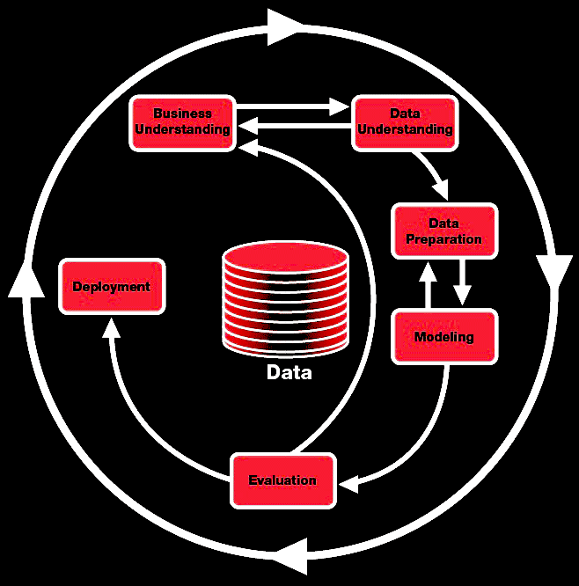
1.2 Data Science Methodologies
CRISP-DM
CRoss-Industry Standard Process for Data Mining

Slide 24
1.2 Data Science Methodologies
CRISP-DM
Business understanding
This initial phase focuses on understanding the project objectives and requirements from a business perspective, then converting this knowledge into a data mining problem definition and a preliminary plan designed to achieve the objectives.
Data understanding
The data understanding phase starts with an initial data collection and proceeds with activities in order to get familiar with the data, to identify data quality problems, to discover first insights into the data or to detect interesting subsets to form hypotheses for hidden information.
Data preparation
The data preparation phase covers all activities to construct the final dataset from the initial raw data.
Modeling
In this phase, various modeling techniques are selected and applied and their parameters are calibrated to optimal values.
Evaluation
At this stage the model (or models) obtained are more thoroughly evaluated and the steps executed to construct the model are reviewed to be certain it properly achieves the business objectives.
Deployment
Creation of the model is generally not the end of the project. Even if the purpose of the model is to increase knowledge of the data, the knowledge gained will need to be organized and presented in a way that the customer can use it.
(Chapman et al., 2000)

Slide 25
1.2 Data Science Methodologies
SEMMA
Pushed by SAS and often in conjunction with SAS tools
“SEMMA offers an easy to understand process, allowing an organized and adequate development and maintenance of DM projects. It thus confers a structure for his conception, creation and evolution, helping to present solutions to business problems as well as to find de DM business goals.”
It is independent of the data mining model(s) and techniques applied.
(Azevedo, 2008)

Slide 26
1.2 Data Science Methodologies
SEMMA
Sample
This stage consists on sampling the data by extracting a portion of a large data set big enough to contain the significant information, yet small enough to manipulate quickly. This stage is pointed out as being optional.
Explore
This stage consists on the exploration of the data by searching for unanticipated trends and anomalies in order to gain understanding and ideas.
Modify
This stage consists on the modification of the data by creating, selecting, and transforming the variables to focus the model selection process.
Model
This stage consists on modeling the data by allowing the software to search automatically for a combination of data that reliably predicts a desired outcome.
Assess
This stage consists on assessing the data by evaluating the usefulness and reliability of the findings from the data mining process and estimate how well it performs.
(Azevedo, 2008)

Slide 27
1.2 Data Science Methodologies
Comparison of Methodologies
KDD | SEMMA | CRISP-DM
Pre KDD |  | Business Understanding
Selection | Sample | Data Understanding
Pre Processing | Explore
Transformation | Modify | Data Preparation
Data mining | Model | Modelling
Interpretation / Evaluation | Assessment | Evaluation
Post KDD |  | Deployment

Slide 28
1.3 Taxonomy & Techniques
https://scikit-learn.org/stable/tutorial/machine_learning_map/index.html

Slide 29
1.3 Taxonomy & Techniques
Supervised vs. Unsupervised Methods
Consider two similar questions we might ask about a customer population.
“Do our customers naturally fall into different groups?”
“Can we find groups of customers who have particularly high likelihoods of cancelling their service soon after their contracts expire?”
No specific purpose or target has been specified for the grouping.
When there is no such target, the data mining problem is referred to as unsupervised.
A specific target defined: will a customer leave when their contract expires?
Segmentation has a specific reason: to take action based on likelihood of churn.
Thus a supervised data mining problem

Slide 30
1.3 Taxonomy & Techniques
Supervised vs. Unsupervised Methods
Consider two similar questions we might ask about a customer population.
Search for groups / patterns using notions of “similar” or “distance”
Build (learn) some function
y = f(x) where y is our dependent variable, and x is 1 or more independent variables
“Do our customers naturally fall into different groups?”
“Can we find groups of customers who have particularly high likelihoods of cancelling their service soon after their contracts expire?”
No specific purpose or target has been specified for the grouping.
When there is no such target, the data mining problem is referred to as unsupervised.
A specific target defined: will a customer leave when their contract expires?
Segmentation has a specific reason: to take action based on likelihood of churn.
Thus a supervised data mining problem

Slide 31
1.3 Taxonomy & Techniques
Types of Problems We Will Look At
Classification: Assigning a label based on specific information
Customers that will/will not cancel their contract
Is spam, is not spam
Type of flower/bug/fish etc.
Students who will/will not pass ADM
Regression: Predict / forecast a value
The price of bitcoin tomorrow / in an hour
The score a collection of students will get in ADM
Clustering: Data segmentation
“Types” of customers/flowers/students etc.
Feature Engineering and Dimensionality Reduction
Deriving data from data
Reducing the amount of data such that it is more manageable

Slide 32
1.3 Taxonomy & Techniques
Starting Point: Supervised Learning
Outcome measurement Y (also called the dependent variable, response, target).
Vector of p predictor variables X (also called inputs, regressions, covariates, features, independent variables, …)
For regression problems, Y is quantitative (e.g. price, score, size, volume)
For classification problems, Y takes a finite (often) unordered set of values (survived / died, stayed / left, digit 0-9) often referred to as class labels
We have some amount of training data (x₁, y₁) … (x_{N}, y_{N}). Our observations (instances, examples) of these measurements
(James et al., 2014)

Slide 33
1.3 Taxonomy & Techniques
Starting Point: Supervised Learning
Using the training data, we aspire to:
Predict unseen test cases (test data)
Typically understand which features influence the outcome (and how)
Assess the quality of our predictions and inferences
It should hopefully be self-evident that we start with simple(r) methods, and do not start straight away with more sophisticated ones!
We also need reasonable assertions of “quality” and also a clear understanding of what determines “high” quality
Note that simple methods are not “bad” in fact they are often as good as their more sophisticated counterparts
(James et al., 2014)

Slide 34
1.3 Taxonomy & Techniques
Starting Point: Unsupervised Learning
No outcome variable, just a set of predictors (features) measured on a set of samples
The objective(s) here is a little more fuzzy:
find groups of samples that behave similarly,
find features that behave similarly,
find linear combinations of features with the most variation.
The term “similar” here is a dangerous one.
In fact, this somewhat abstract idea “similar” means it can be very difficult to know if you have/have not done a good job.
Unsupervised learning is very useful in data exploration, or as a pre-processing step prior to the application of a supervised model.
(James et al., 2014)

Slide 35

1.4 Summary
History & Evolution
Data Science Methodologies
Taxonomy & Techniques
Bibliography/References
Azevedo, A. I. R. L. (2008). KDD, SEMMA and CRISP-DM: a parallel overview.
Brachman, R. J., & Anand, T. (1996, February). The process of knowledge discovery in databases. In Advances in knowledge discovery and data mining (pp. 37-57). American Association for Artificial Intelligence.
Chapman, P., Clinton, J., Kerber, R., Khabaza, T., Reinartz, T., Shearer, C., & Wirth, R. (2000). CRISP-DM 1.0 Step-by-step data mining guide.
Fayyad, U. M. (1996). Data mining and knowledge discovery: Making sense out of data. IEEE Intelligent Systems, 11(5), 20-25.
Fayyad, U. M., Piatetsky-Shapiro, G., Smyth, P., & Uthurusamy, R. (1996). Advances in knowledge discovery and data mining.
James, G., Witten, D., Hastie, T., & Tibshirani, R. (2014) An Introduction to Statistical Learning with applications in R.
Leskovec, J., Rajaraman, A., & Ullman, J. D. (2014). Mining of massive datasets. Cambridge University Press.
Lantz, B. (2013). Machine learning with R. Packt Publishing Ltd.
Hand, D.J. (2010). Intelligent Data Analysis. Springer.

